Slide 1
KanBan
看板
Cyril Donnellan
Stephen Mulcahy
Joe O Flaherty

Slide 2
Background
Manufacturing
Developed by Toyota 1940’s.
Inspired by observing supermarket staff.
Toyota Production System(TPS).
Workers used ‘kanban’ cards.
Literally “visual sign”.
Evolved into Lean Manufacturing methodology.
“making obvious what adds value by reducing everything else”
Software Development
Tom and Mary Poppendieck - Lean Software Development: An Agile Toolkit 2003.
Adapted key Lean manufacturing principles.
Eliminate waste
Amplify learning
Decide as late as possible
Deliver as fast as possible
Empower the team
Build integrity in
See the whole
David J Anderson created first virtual Kanban circa 2005 - Developed Kanban as a Lean SW development management method.

Slide 3
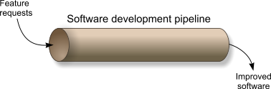
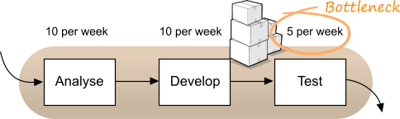
What is KanBan ?
A technique for managing a SW development process efficiently
by applying 5 simple principles.
Visualize the work
Limit work in progress
Focus on flow
Agree process policies
Continuous improvement
http://kanbanblog.com
Initial WIP limits and policies for changing or temporarily breaking them
Process for prioritising and selecting features
Policies for different classes of service (e.g. "standard", "expedite", "fixed delivery date"). Are estimates needed?
When choosing work, which will be selected first?
Frequency of reviews

Slide 4
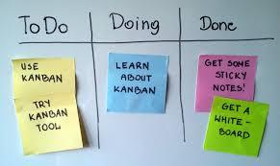
Why use a physical board
The human brain processes visual information approximately 60,000 times faster than text.
40% of all nerve fibres connected to the brain are linked to the retina.
Ninety percent of the data that enters our brain is visual.
Our neurological pathways favour pictorial displays over textual information.
Seeing how work flows within a process aids communication of status and gives clearer context to work.
Kanban simply takes information that typically would be communicated using words and turns it into a physical ‘picture’.

Slide 5
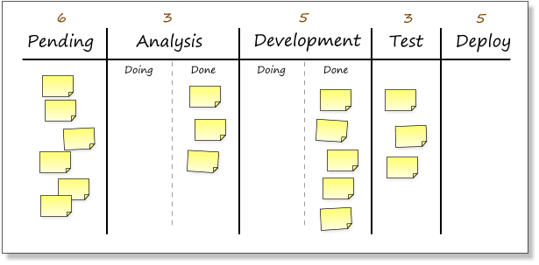
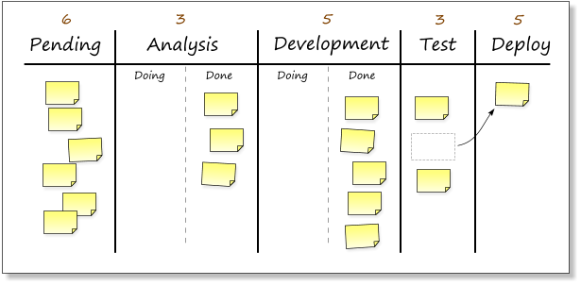
How it works
Helps visualize workflow and identify bottlenecks in the development pipeline.

Slide 6
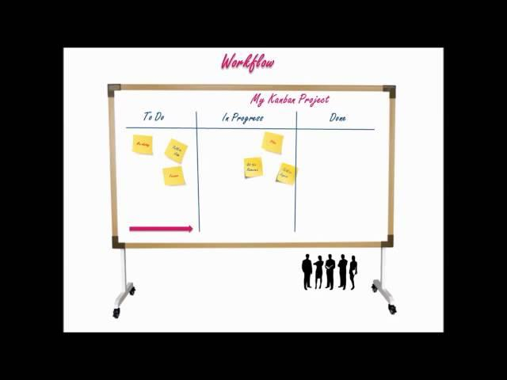
KanBan in 60 Seconds

Slide 7
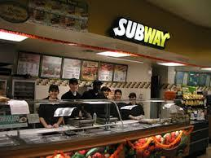
Sandwiches !
When you get up to the counter at a Subway, someone asks you what you would like and lays out the bread and meat for your order.
Your sandwich and you do not move forward until the next staff member has the capacity to put on your toppings.
Once your toppings are put on you might have to wait for dressing or to pay.
http://venturebeat.com
You have just been part of a Kanban system.
The sandwich was the visual cue moving through various phases of work.

Slide 8
Time yourself
Time yourself counting from 1 to 26.
Time yourself saying the alphabet a to z.
Add up the times.
Now time yourself counting from 1 to 26 while alternating saying the alphabet, so 1, a, 2, b, 3, c, etc.
Were you faster at saying each sequence individually or when you alternated?
Kanban helps reduce task switching by limiting work-in-progress (WIP).
Before any new item can be introduced in that work step, there must be capacity.

Slide 9
Pros & Cons
Pros
Potential baseline for Personal Software Process.
Low financial cost.
Easy to understand.
Easily implemented.
Implementable by individual teams even if an entire organisation does not adopt Kanban.
Cons
Lack of 100% commitment makes the system redundant.
Easily manipulated for the wrong reasons - too low a limit on WIP set deliberately.

Slide 10
Kanban software tools
Trello - https://trello.com/
Kanbanize - https://kanbanize.com/
Leankit Kanban - http://agilescout.com/tool-review-leankit-kanban-optimize-your-flow/
Kanban Tool - http://kanbantool.com/kanban-software

Slide 11
More information
Step by Step - http://refcardz.dzone.com/refcardz/getting-started-kanban#refcard-download-social-buttons-display
Why Kanban can fail - http://www.slideshare.net/pawelbrodzinski/kanban-weak-spots Fun examples - http://venturebeat.com/2013/09/02/why-kanban-is-the-cure-to-your-companys-multitasking-plague/

Slide 12
Thank You
Questions??

